Slide 1

Biometric Student Attendance App
System Modeling & Design

Slide 2

Introduction
The system modeling and design of a biometric student attendance system involve creating an advanced, secure, and efficient method for recording and managing student attendance in educational institutions

Slide 3
Agenda
System Architecture
Interactions
Data Flow
Object-Oriented Solution
Actors & Use Cases
Presentation Title

Slide 4


System Architecture
SYSTEM MODELLING & design

Slide 5
System Architecture
Mobile Application (React Native)
Backend Server (Node.js, Express.js)
Mobile Phones, Laptops, fingerprint devices
Authentication Module (Auth0)
Attendance Module
Notification Module
Presentation Tier (Client-side)
Application Tier (Server-side Logic)
Data Tier (Database & Storage)
Reporting Module
User Management
Database Storage (Cloud MongoDB)
User data, logs, record, reports

Slide 6
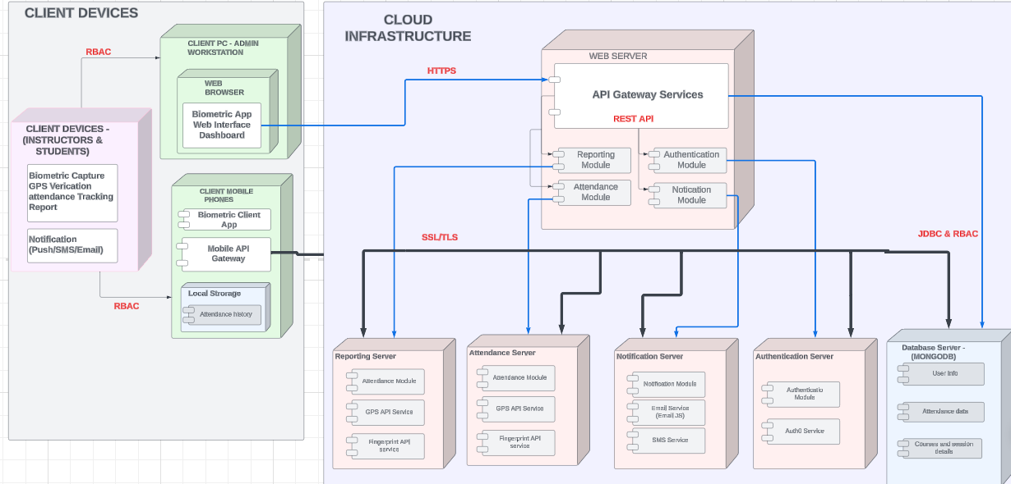
Deployment Diagram

Slide 7
Data Flow
SYSTEM MODELLING & design

Slide 8
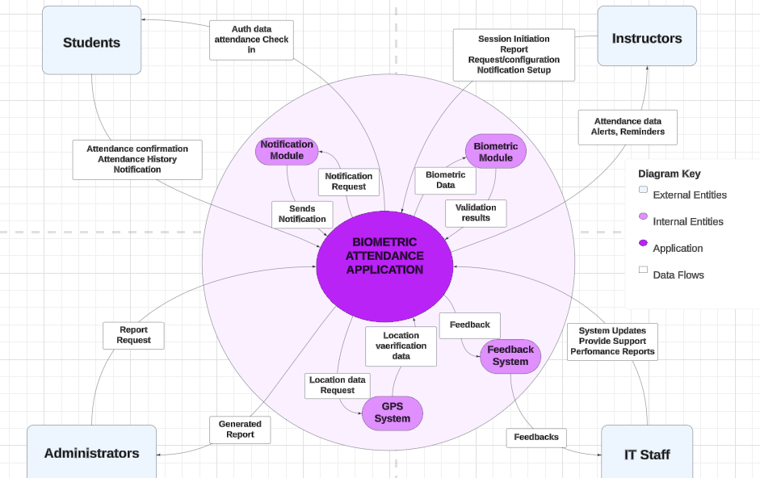
Context Diagram

Slide 9
Actors & Use Cases
SYSTEM MODELLING & design

Slide 10
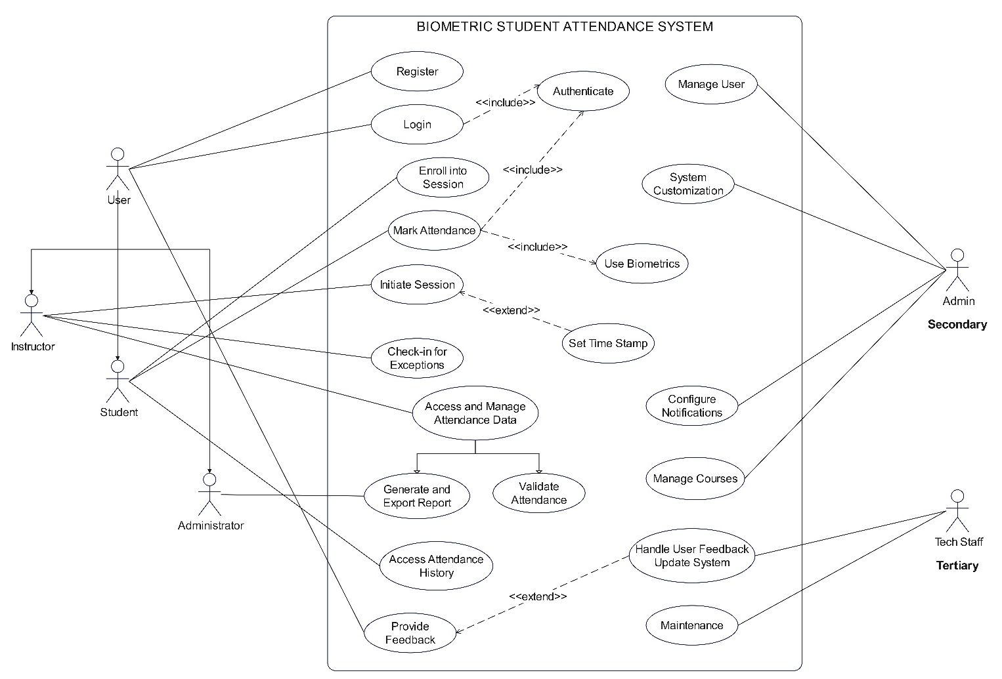
Use Case Diagram

Slide 11
Functional Requirements Mapping
Functional Requirement | Use Case
Biometric Data Capture | Registration -> use Biometric
Enrollment and Authentication Module: | Registration Login
Real-time Attendance Tracking | Initiate Attendance Mark Attendance Stop Attendance
Reporting | Generate Report

Slide 12
Interactions
SYSTEM MODELLING & design

Slide 13

Overview of Sequence Diagram
User Authentication Sequence
Attendance Marking Sequence
Users register by providing required user information
Users login using credentials and are authorized after authentication
Instructor initiates attendance session
System captures and verifies biometric data
System logs attendance into attendance system

Slide 14
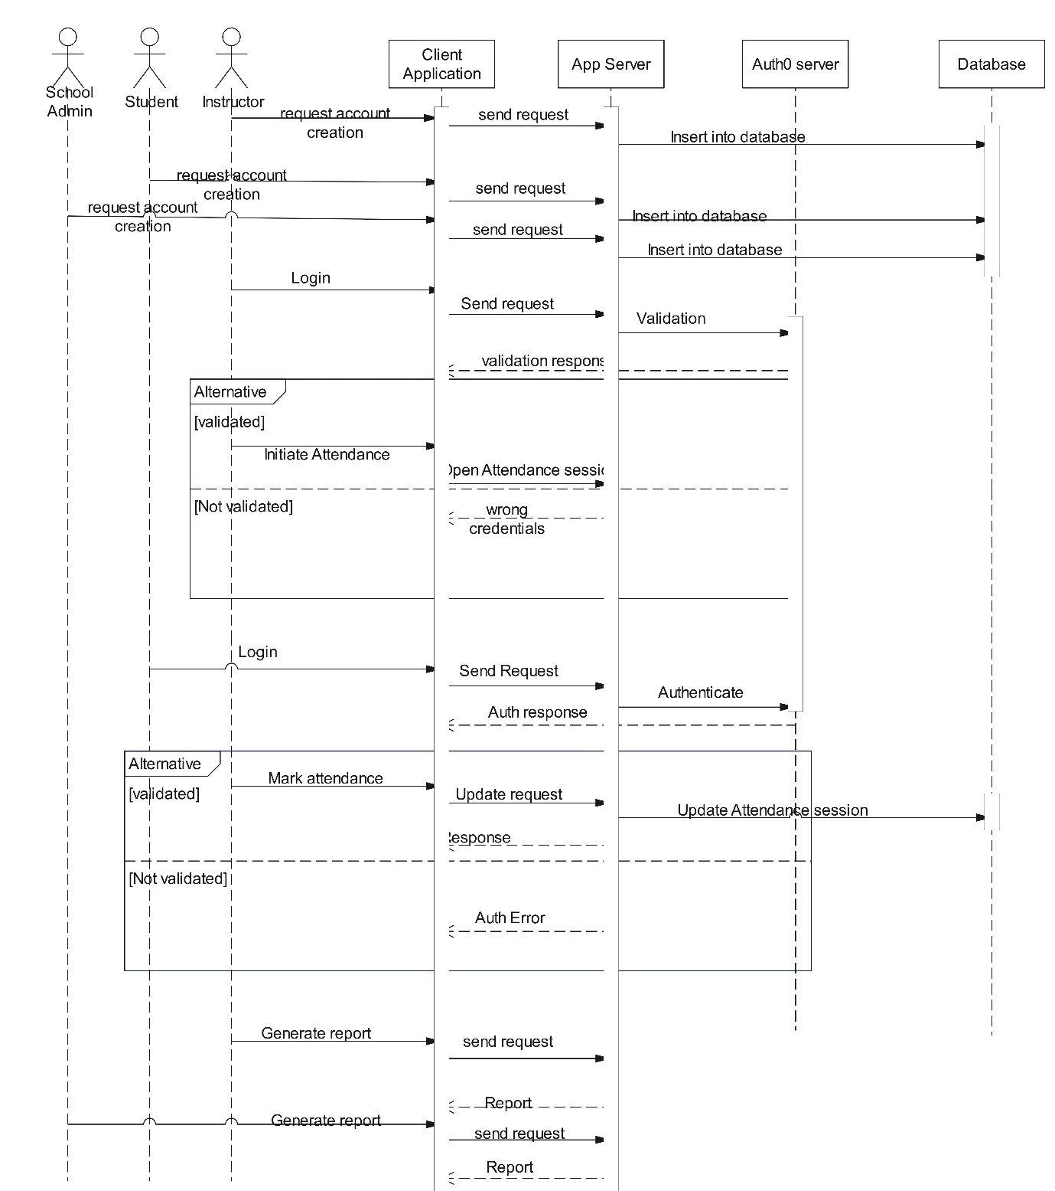
Sequence Diagram

Slide 15
Object-Oriented Solution
SYSTEM MODELLING & design

Slide 16
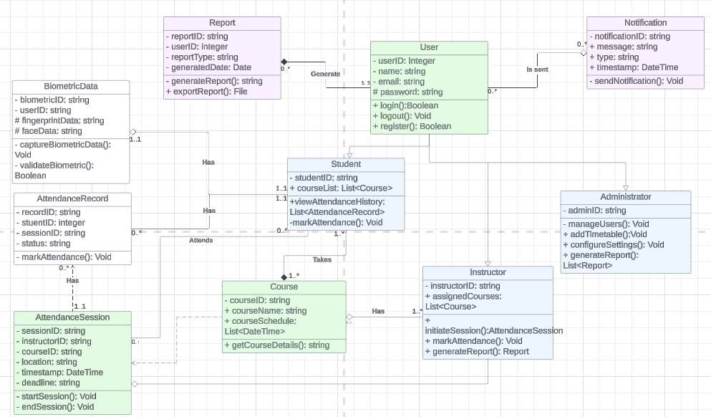
Class Diagram

Slide 17



Security & Performance Considerations
Security architecture
Biometric data protection
Authentication server security
User privacy
Logging and monitoring
Performance optimization strategies
System scalability and customizability
Response time and accuracy
System reliability
Implementation strategies
Security enhancements
Performance enhancements

Slide 18


Conclusion
The development of the Mobile Attendance System aims to revolutionize the way attendance is tracked and managed in educational and professional environments. By integrating cutting-edge technologies such as biometric authentication, real-time attendance tracking, and comprehensive reporting, this system offers a robust solution to modern attendance challenges.

Slide 19




Thank you

